Slide 1
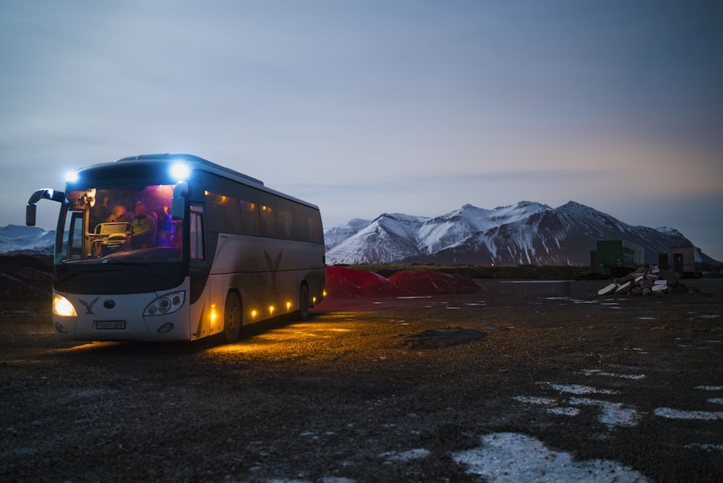
BUS RESERVATION SYSTEM
K.M.Architha
K.Swathi
A.Adheeba Banu
P.Deepika
R.Inika

Slide 2

ABSTRACT
A simple bus ticket booking system.
Users can register, login, book tickets for bus routes, view booked tickets, and cancel tickets.
A text-based interface for interacting with the booking system.
Uses arrays to store user data, bus routes, and bookings.

Slide 3
LEVEL FLOW

Slide 4
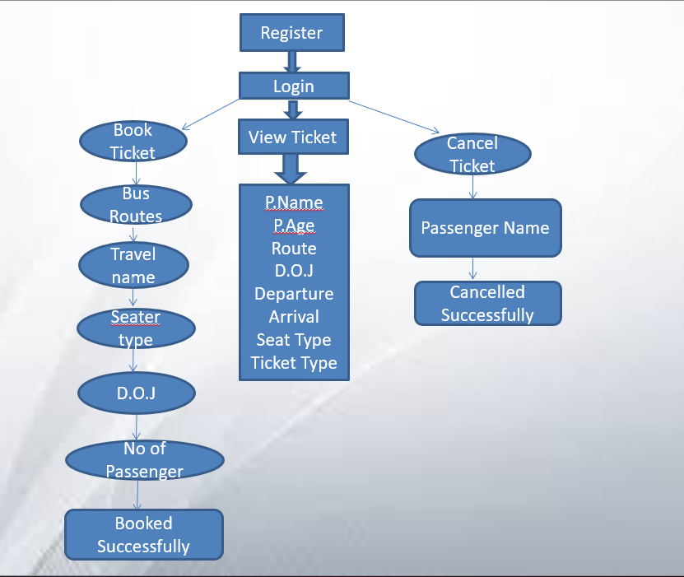

Slide 5

LANGUAGE USED

Slide 6
Classes
User (Attributes:Username,Password)
Busroute(Attributes: route number, origin, destination, departure time, arrival time, seat type, and ticket price)
Booking(Attributes:passenger name, passenger age, date of journey, associated bus route)
BusTicketBookingSystem(Methods:user interaction such as login, registration, booking tickets, viewing booked tickets, and canceling tickets)

Slide 7
Why oops
Encapsulation: Organizing related data and behavior into classes improves maintainability and readability.
Abstraction: Hiding complex implementation details behind simple interfaces makes the system easier to understand and use.
Inheritance: Allows for creating new classes based on existing ones, promoting code reuse and extensibility.
Polymorphism: Enables objects to be treated as instances of their parent class, providing flexibility and simplifying code.

Slide 8
MODULES
Main:
This is the entry point of the program.
It handles the main menu for logging in, registering, and exiting the application.
It also calls other methods based on user input.
Login:
This method handles the login functionality.
It prompts the user for a username and password, checks if the credentials are valid, and returns a boolean value indicating whether the login was successful.
Register:
This method handles the user registration process.
It prompts the user for a username and password
Stores the credentials in arrays.

Slide 9
DisplayBusRoutes:
This method displays the available bus routes based on the user's choice.
It then prompts the user to select a travel name and seat type.
DisplayBusDetails:
This method displays the details of a selected bus, including the bus number, seats available, route, departure and arrival times, and ticket price.
BookTickets:
This method handles the booking of tickets.
It prompts the user for the date of journey, number of passengers, and passenger details (name and age), and stores the booking details in the booked Tickets array.

Slide 10
FUNCTIONALITIES
User Registration: Users can register by providing a username and password.
User Login: Registered users can log in using their username and password.
Bus Route Selection: Users can select a bus route from a list of available routes.
Travel Name Selection: After selecting a route, users can choose a travel name from the available options.
Seat Type Selection: Users can choose between a seater or sleeper seat type.

Slide 11
Display Bus Details: The program displays details of the selected bus, including the bus number, seats available, route, departure and arrival times, and ticket price.
Ticket Booking: Users can book tickets by providing the date of journey, number of passengers, and passenger details (name and age).
View Booked Tickets: Users can view their booked tickets, including passenger details, route, date of journey, departure and arrival times, and bus fare.
Cancel Ticket: Users can cancel a booked ticket.Exit: Users can exit the application.
Exit: Users can exit the application.

Slide 12
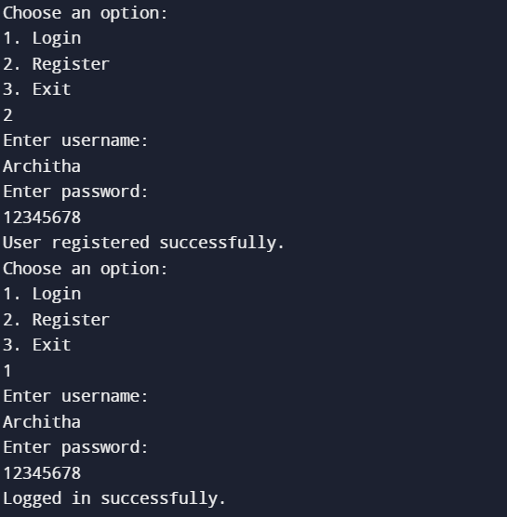
Output:

Slide 13
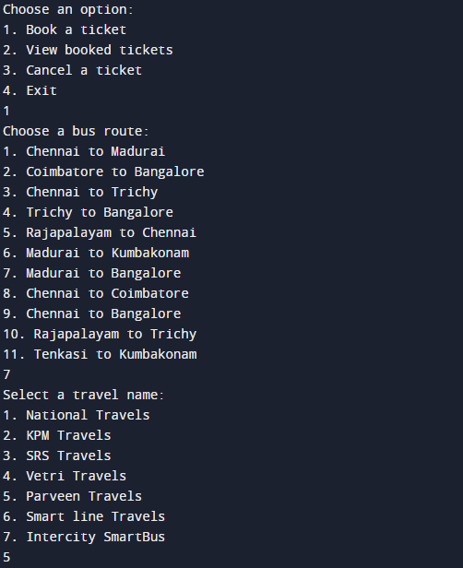

Slide 14
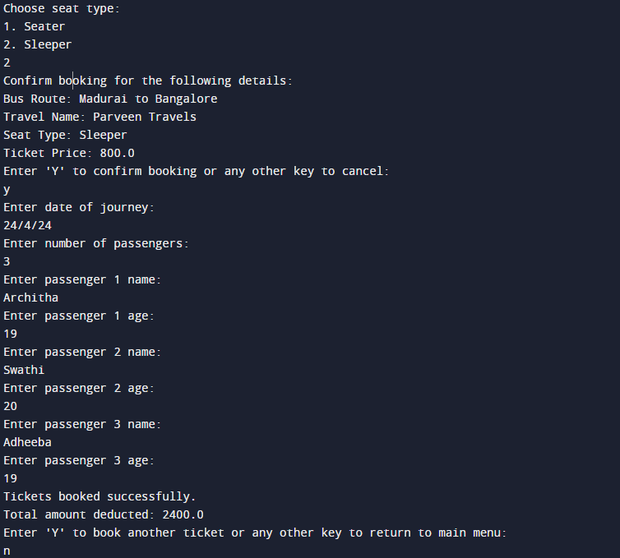

Slide 15
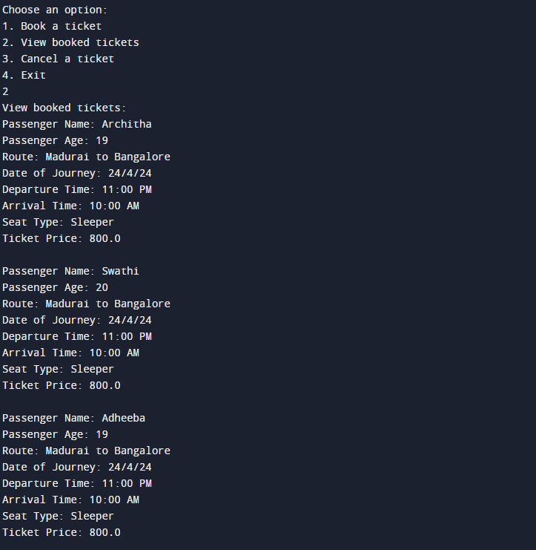

Slide 16
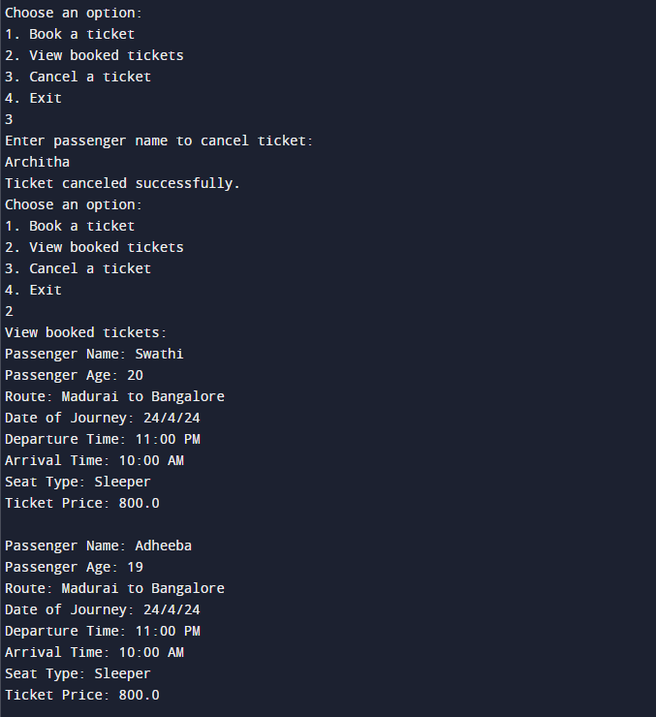

Slide 17
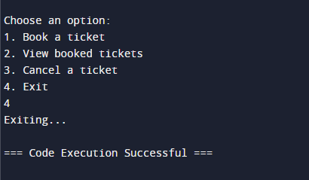

Slide 18
CONCLUSION
The program features classes such as User, BusRoute, Booking, and BusTicketBookingSystem, each representing a specific entity in the system.
Object-oriented concepts such as encapsulation, inheritance, and association are used to model the system's entities and their interactions.
The program allows users to register, log in, book tickets, view booked tickets, and cancel tickets, providing a basic but functional user experience.
While the program provides a foundation for a bus ticket booking system, it could be further enhanced with features like payment processing, seat selection, and real-time availability updates to improve its functionality and user experience.

Slide 19


